Slide 1
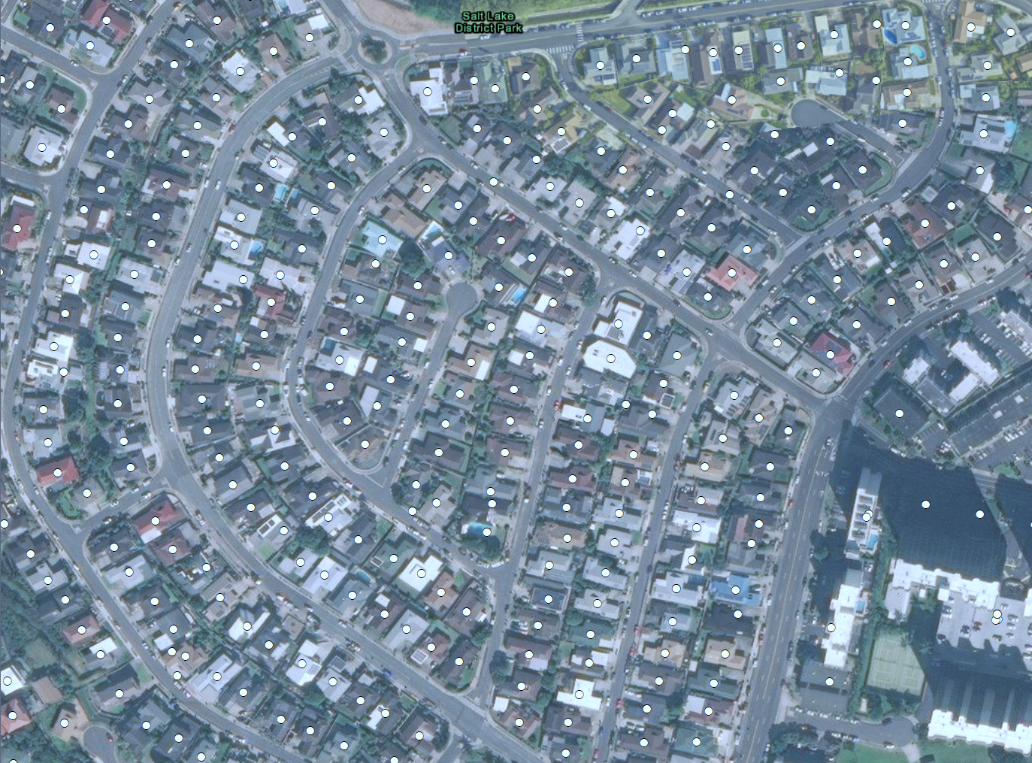
NSI2
Tidying Up the National Structure Inventory
Nick Lutz
Alex Ryan

Slide 2
Overview
NSI replacement using ESRI, CoreLogic, and Microsoft data to greatly improve accuracy
We’ll answer questions you may have such as:
Where are you getting data?
What’s new?
How’d that work out for you?
When are other things happening?

Slide 3
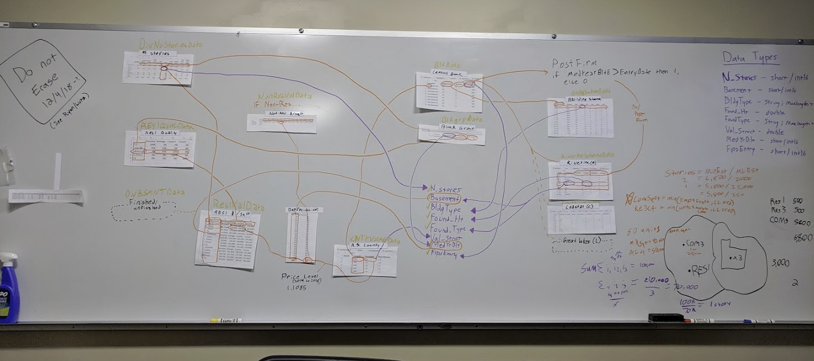
Data Sources
ESRI
Non-residential structures (incl. RES4, 5, & 6)
Location, occtype, number of employees
CoreLogic
Residential structures (RES1, 2, and 3)
Location, occtype, residential housing units, year built, number of stories
NCES
Schools (EDU1 only)
Location, occtype, teacher and student counts
Microsoft
Structure footprints, incl. centroid location and perimeter/footprint area
CoreLogic
Parcel locations, used to match structures to Microsoft footprints
LEHD
Worker counts by residential location and working census block
Census
Census block population and housing unit counts
Structure characteristic data
FEMA/HAZUS
FIRM Flood zone maps
Structure characteristic data

Slide 4

Data Sources
Layered, composite approach
Gaps in higher resolution data filled with next best available
Examples:
Structures with missing Microsoft footprints placed at parcel centroid
Missing ESRI, CoreLogic structures filled from NSI1

Slide 5
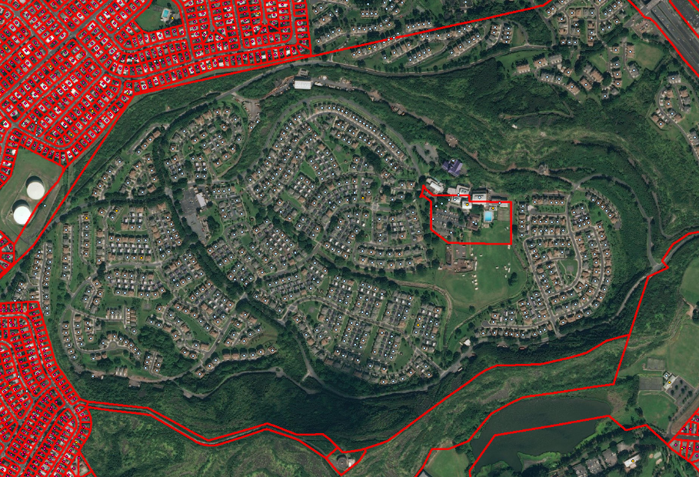
Data Sources
Available data is used together in any combination
Here CoreLogic structures are not available, NSI1 structures are combined with Microsoft footprints yielding high degree of geospatial accuracy

Slide 6
Improvements over NSI1
Geospatial Location
Number of stories
Improved population assignment
Structure values
FIRM data and other added information
Better platform for future enhancements

Slide 7
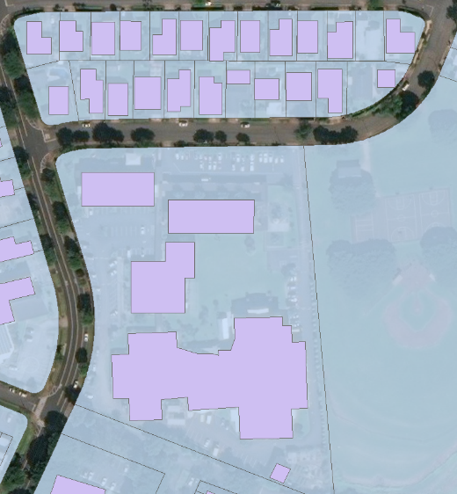
Improvements - Geospatial Location
NSI1 accurate to Census block level
Refined by developed area layer
NSI2 adds 2 additional layers of precision, given availability:
Parcel level (CL, ESRI)
Structure footprint level (Microsoft)
Structure “node” precision as well as, to a lesser degree, discrete structure location precision (i.e. geospatial distribution of structure nodes by type)

Slide 8
Improvements - Geospatial Location
CENSUS BLOCK
NSI1 structures distributed evenly across developed areas of Census block
Structure occupancy type does not inform location
RES
COM

Slide 9
Improvements - Geospatial Location
NSI2 uses both parcels and Microsoft footprint data to refine placement
CoreLogic/ESRI parcels create structure type based placement
In multi-structure parcels structures distributed according to type
3x Com
2x Com
2x Com
RES3B
RES3B
1x Com
1x Com
6x Res1
1x Com

Slide 10
Improvements - Geospatial Location
NSI1
NSI2

Slide 11
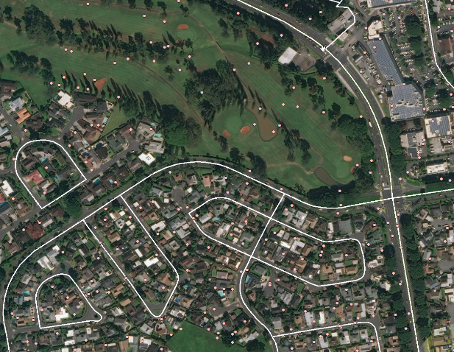
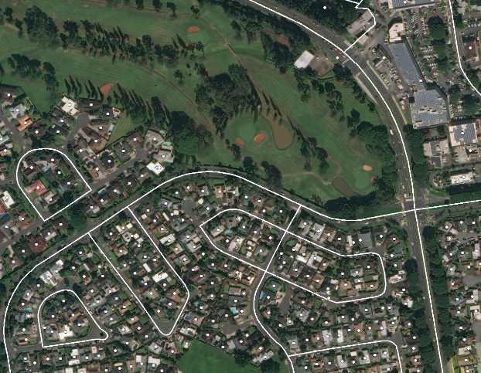
Improvements - Geospatial Location
NSI1
NSI2

Slide 12
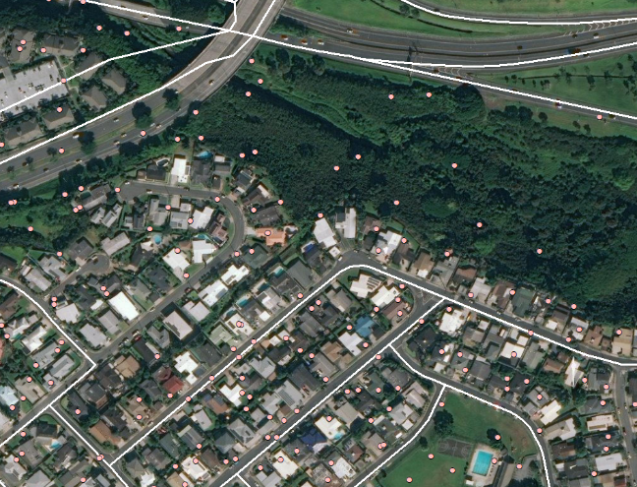
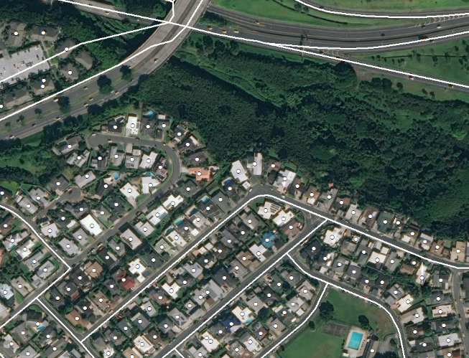
Improvements - Geospatial Location
NSI1
Potential floodway
NSI2
Potential floodway

Slide 13
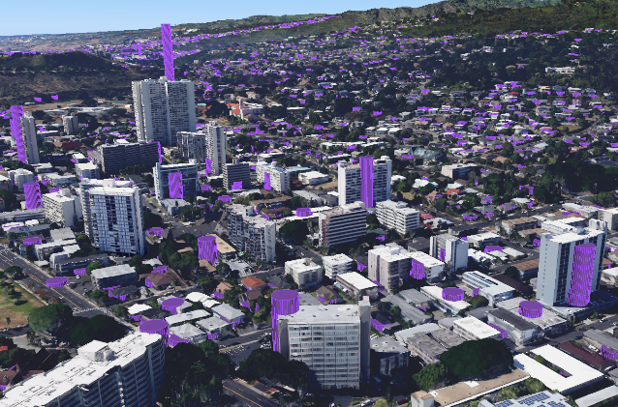
Improvements - Number of Stories
NSI1 number of stories
Residential – based on regional averages
Non-residential – based on generic assumptions
NSI2 number of stories is a composite of different sources/assumptions
Residential – based on regional avg, by year
Non-residential – computed based on employee or other occupant counts

Slide 14
Improvements - Number of Stories
Residential number of stories calculated similarly to NSI1, with additional use of structure year built

Slide 15

Improvements - Number of Stories
Non-residential number of stories estimated using total employees and residential units, avg sq ft per employee/unit by occupancy type
Needed minimum sq ft from this calculation converted to number of stories using perimeter
Either from Microsoft footprints or estimated by occtype avg

Slide 16
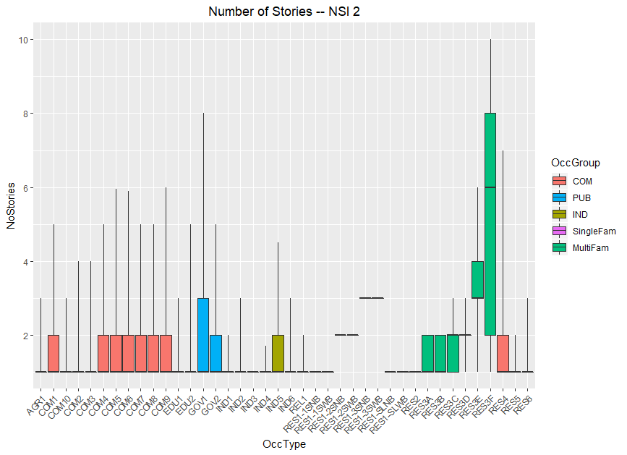
Improvements - Number of Stories
NSI2 approach results in variability in number of stories by structure

Slide 17
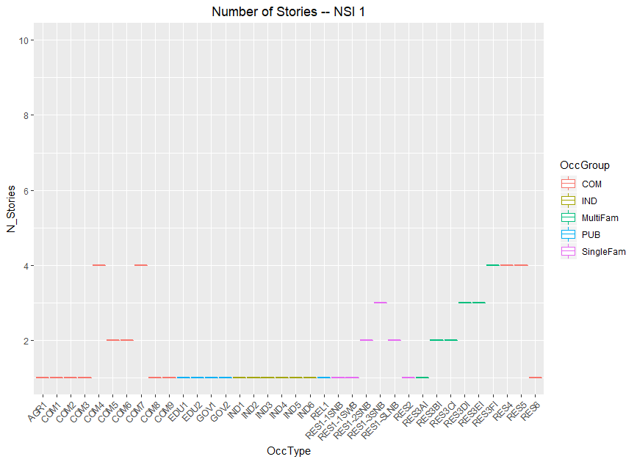
Improvements - Number of Stories
NSI1 number of stories assigned fixed values at occtype level

Slide 18
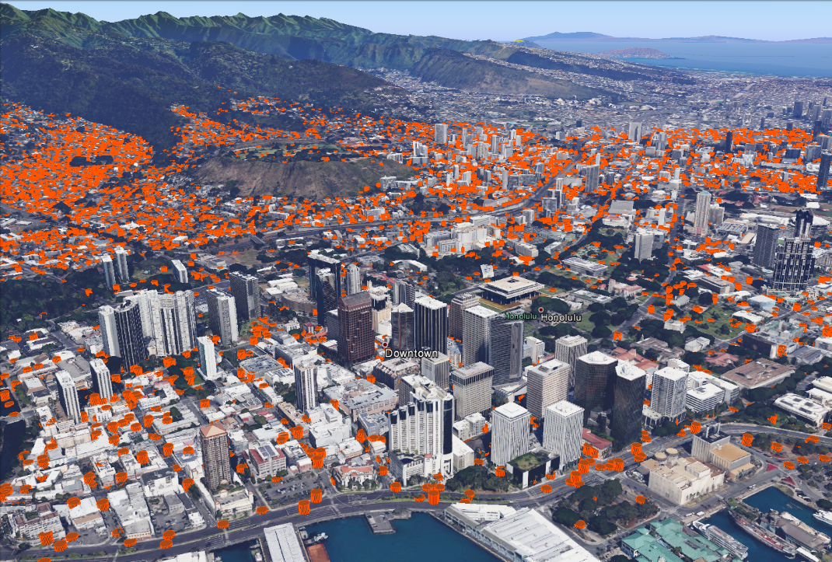
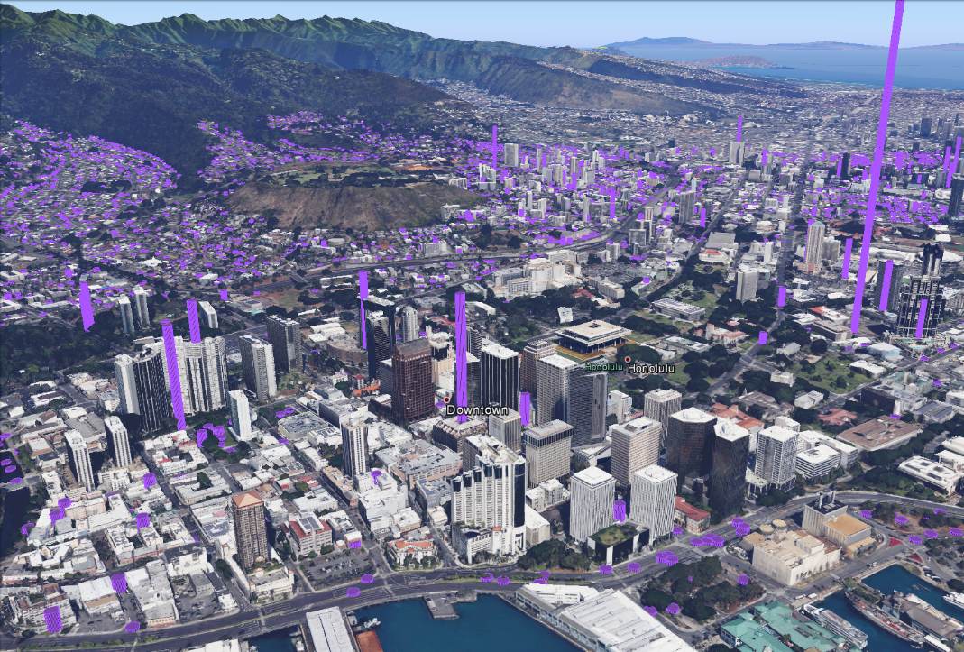
Improvements - Number of Stories
NSI2 better captures this variability by basing estimate on structure specific characteristics
NSI1 approach does not capture meaningful geospatial variation in numbers of stories
NSI1
NSI2
This weird space elevator thing suggests further room for improvement
(It’s not our fault though, promise)

Slide 19
Improvements - Population Assignment
Population assignment incrementally improved over NSI1, using similar approach
NSI2 uses working population over 65 from LEHD to refine estimates of over 65 population at non-residential structures
NSI2 uses structure specific data (residential units/employee counts) to weight population instead of occtype level averages
Population growth relative to 2010 Census inputs added first to areas of new development
Improved coverage
Improved distribution of over 65 population in non-residential structures
Improved geospatial distribution of working population

Slide 20
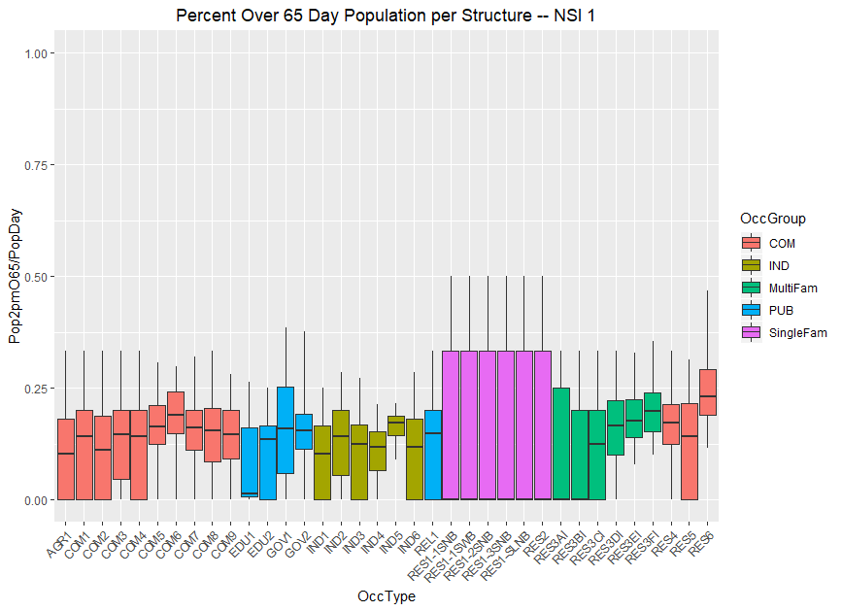
Improvements - Population Assignment
NSI1 assumed over 65 population were equally likely to work as under 65 population

Slide 21
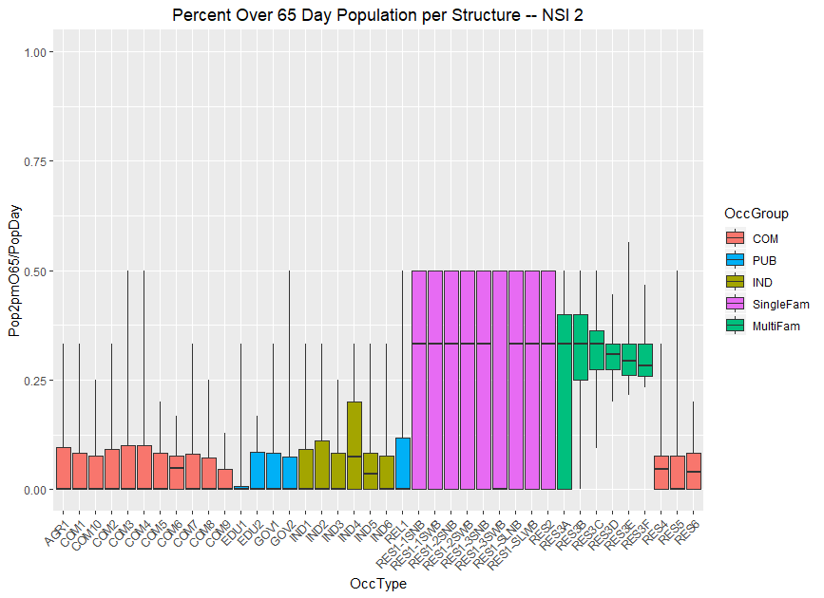
Improvements - Population Assignment
NSI2 uses LEHD data on % of elderly population per Census block working to distribute over 65 workers
Results in significantly reduced over 65 population in non-residential structures

Slide 22
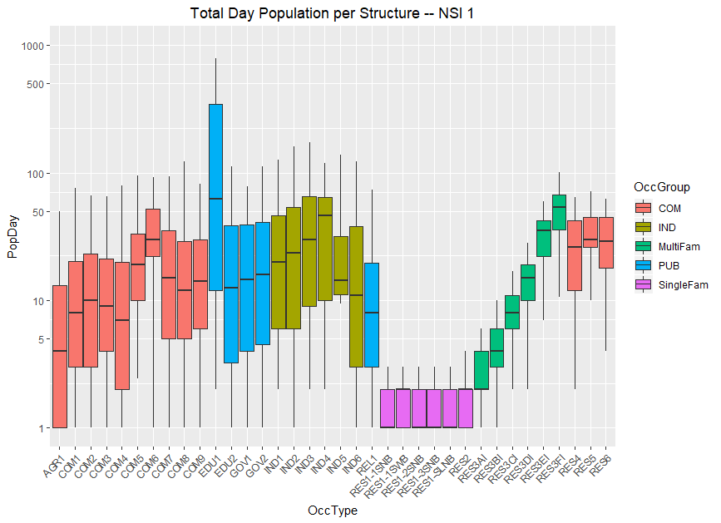
Improvements - Population Assignment
Population assignment in NSI1 done by occtype level weights

Slide 23
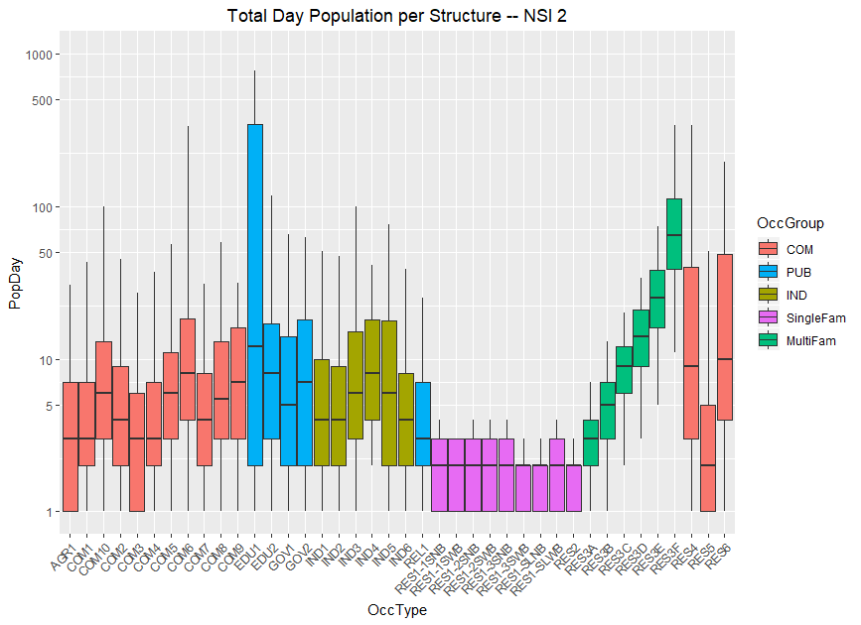
Improvements - Population Assignment
NSI2 population assignment by employee counts and residential units results in more granular distribution
Tall Office buildings absorb a lot of PAR
Short gas stations absorb a little PAR

Slide 24
Improvements - Structure Value
Structure value improvements largely dependent on:
Better estimates of structures’ square foot
Fewer generics
Better estimate of basement status
Indexed price levels
Depreciation

Slide 25
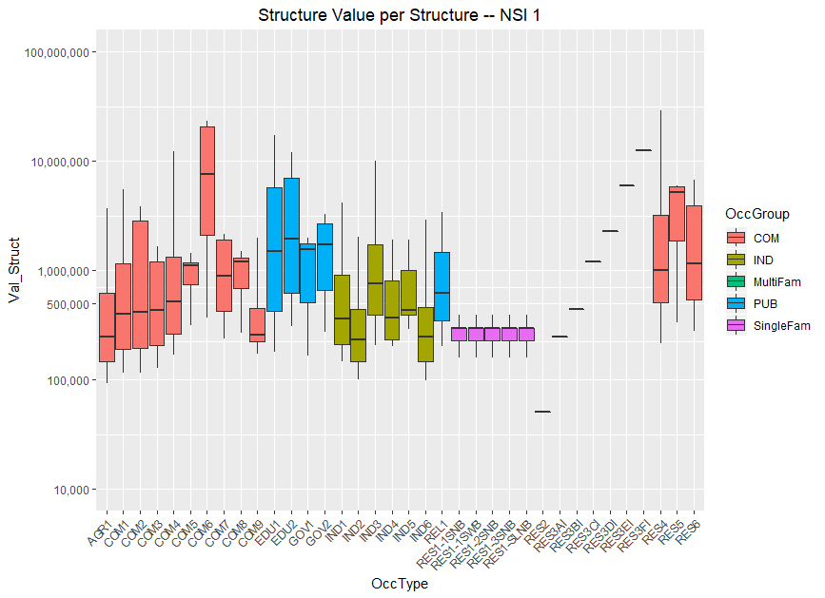
Improvements - Structure Value
NSI1 structure value assumed generic multi-family square feet
RES1 value was split equally among all structures
Regardless of number of stories or basement status

Slide 26
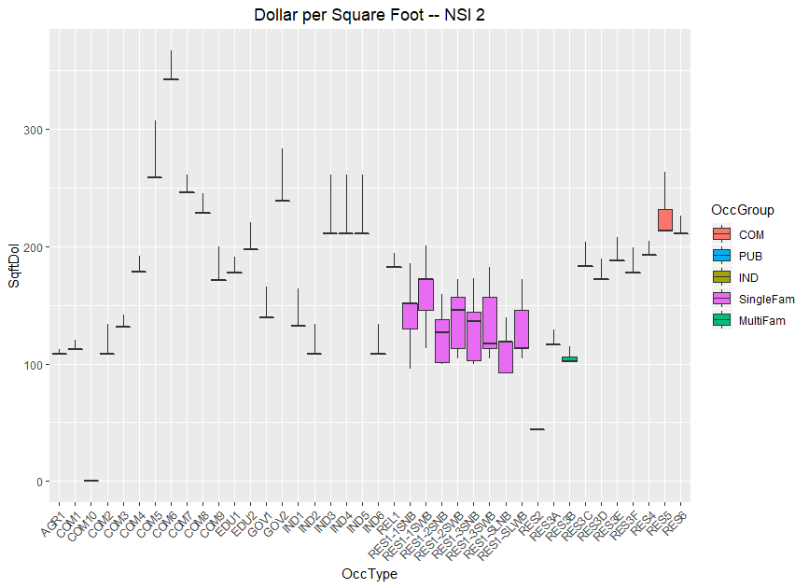
Improvements - Structure Value
NSI2 adjusts for:
Locality (as did NSI 1)
Depreciation (median year built)
RES1s also adjusted for
Number of stories
Basement
Quality (Block Group median income ratio)

Slide 27
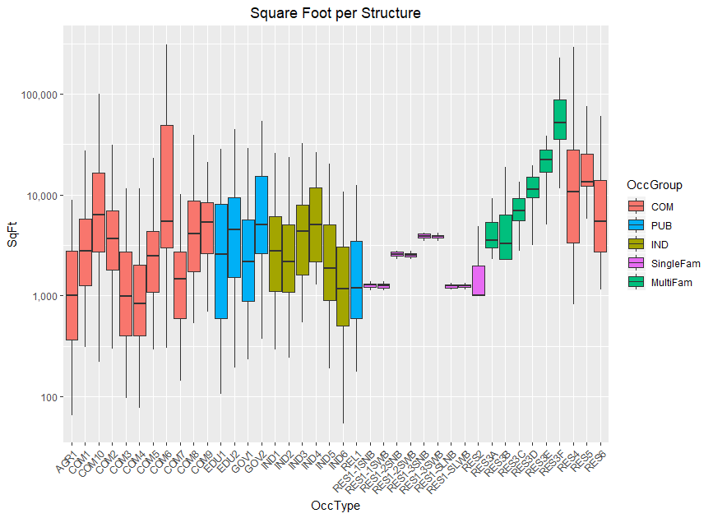
Improvements - Structure Value
Square foot = Footprint area * number of stories
RES1:
Footprints and number of stories are determined by
Year built
Census Region
Non-RES1:
Microsoft, and/or,
Generic & number of employees estimates

Slide 28
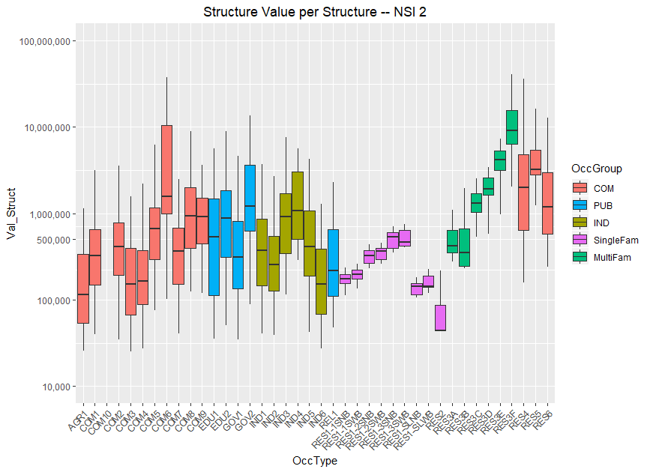
Improvements - Structure Value
NSI2 simply multiplies the estimated SqFt by the determined $/SqFt

Slide 29
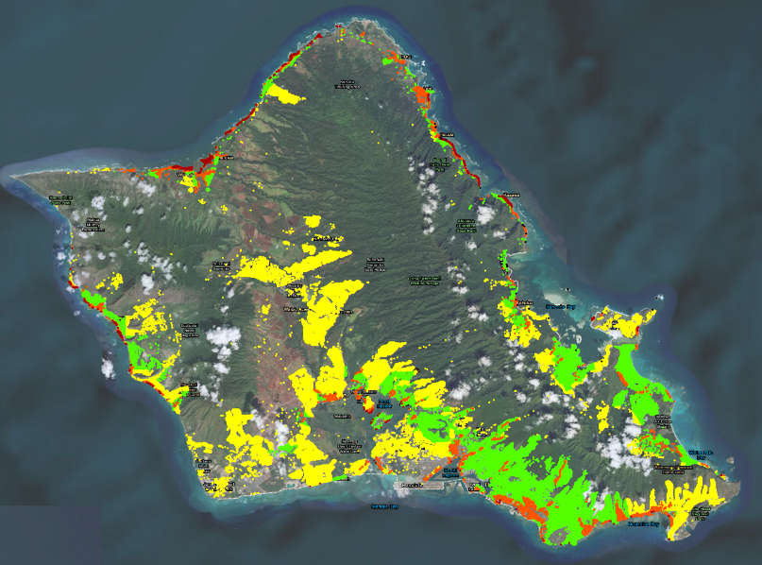
Improvements – FIRM Map Flood Zone
X Zone
D Zone
A Zone
V Zone
If in a V-Zone
More likely to have pier/pile foundation type
More likely to have high foundation height
Otherwise
Assume the HAZUS A-Zone distribution of type and height (pre/post FIRM)
Also, kept as a field for informational purposes

Slide 30
Limitations
NSI2 methodology relies on wider array of datasets than NSI1
Inaccuracies/misalignments between these can result in inaccurate structure level data
Structure Footprints
RES4, RES5, RES6 population assignment
“Split” structures
CoreLogic data inconsistently differentiating single structures vs developments

Slide 31
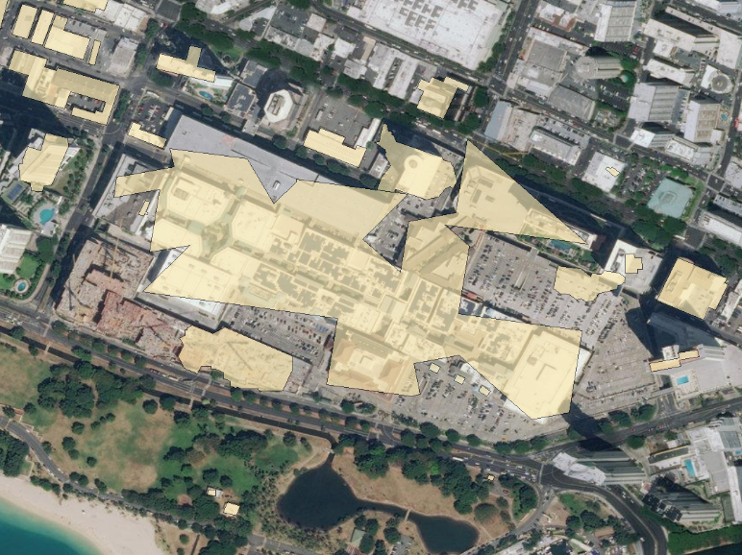
Limitations - Structure Footprints
Microsoft footprints do not always accurately capture structures
Large, multi-story structures/complexes worst offenders
Relatively common in heavily urban or industrial areas
Leads to inaccurate square footage and value, can lead to inaccurate number of stories
Structures are sometimes associated with the wrong footprint (e.g. RES2 to large commercial structure footprint)

Slide 32
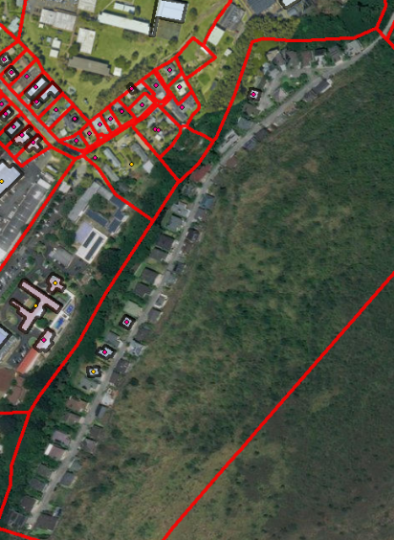
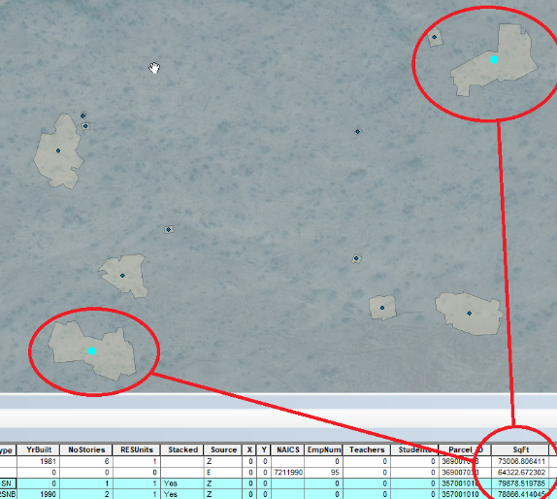
Limitations - Structure Footprints
Incomplete footprint coverage in parcel result in incorrectly stacked structures
False positive or inaccurate footprints can result in inaccurate square footage, value assignment

Slide 33
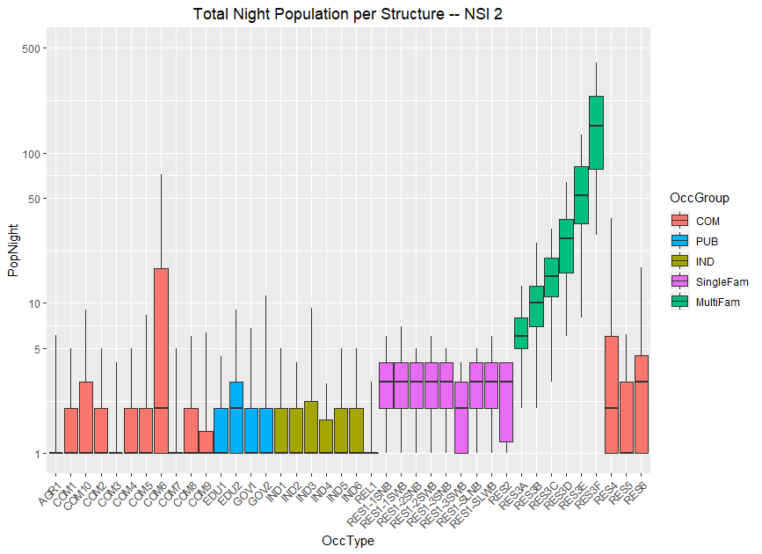
Limitations - RES4, RES5, & RES6 Population Assignment
RES4, RES5, and RES6 structures taken from ESRI data rather that CoreLogic
Population assignment by employee count rather than residential units
Missing population
Now treated similar to e.g. customers at COM1’s

Slide 34
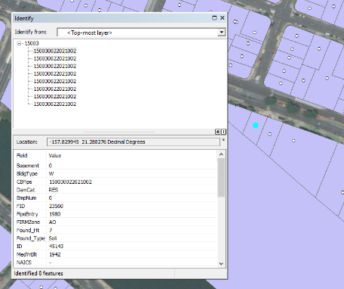
Limitations - “Split” Structures
CoreLogic data sometimes reports large developments as single, RES1 classified structure
Results in individual RES1 structures with hundreds of people assigned
Current approach identifies structures, splits them into sub-structures based on maximum population per housing unit
These split structures are marked “S” in the “stacked” field
Structures would need to be moved by modelers as appropriate

Slide 35
State Level Comparisons: Hawaii
NSI 1
Has not been updated to reflect CL based data
NSI 2

Slide 36
State Level Comparisons: Virginia
NSI 1
Has not been updated to reflect CL based data
NSI 2

Slide 37
Model Result Comparisons
Has not been updated to reflect CL based data

